Slide 1
2019년 CPBMI 4조 결과발표 2019-08-24

Slide 2
4조 주제 및 목표
지난 줄거리
EMR + Genome
: 임상정보와 유전체 정보의 통합분석을 통한
1) 임상문제 해결과제를 도출하고
2) 문제해결 과정을 도출한다
Precision Medicine
Prediction & Personalized Intervention

Slide 3
진행현황 (1) - 주제도출
지난 줄거리
김명수 – 비뇨기과
김선숙 – 가정의학과
김홍규 – 안과
노명균 - 병리과
변민수 – 정신건강의학과
서제현 – 안과
설보람 – 안과
신성 - 이식외과
비만

Slide 4
연구주제 제안 by clinician’s request
지난 줄거리
기존 비만의 정의
BMI(체질량 지수)에 따라서
허리둘레에 따라서
체지방에 따라서

Slide 5
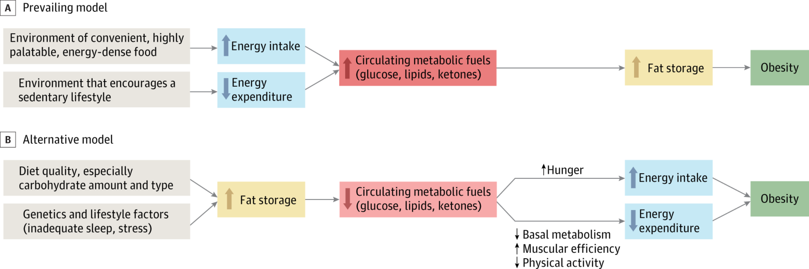
Obesity management에 있어서 genetics의 중요성
지난 줄거리
JAMA. 2014;311(21):2167-2168. doi:10.1001/jama.2014.4133

Slide 6


임상-유전체 정보 통합 모델 기반 obesity risk score calculation
지난 줄거리
Current Status
Clinical variables obtained from EMR data
: BMI 등의 임상정보
Genetic information (risk/protective variant)
: Obesity 관련 genetic variant 정보
Genetic Risk

Slide 7
지난 줄거리
임상정보 입력
유전체 정보 입력
BMI(체질량 지수)
= 체중(kg) / 키(m)²
30이상 : 고도비만
25~29.9 : 비만
23~24.9 : 과체중
18.5~22.9 : 정상
Obesity-related
genetic risk score
- based on previously reported genetic variants
(polygenic risk score)
Obesity Risk
Score
HIGH RISK
MODERATE RISK
LOW RISK
Risk group에 따른 intervention (genetic risk score까지 반영한 active prevention)

Slide 8
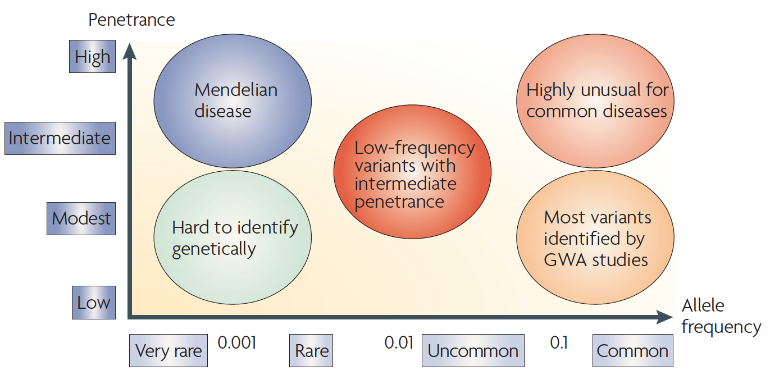
By frequency and effect size
지난 줄거리

Slide 9
비만 유전자
지난 줄거리
비만과 관련된 gene
FTO: 남는 열량을 지방으로 저장
MC4R: 식욕억제를 통한에너지 섭취균형을 조절
BDNF: 사회적 스트레스나 우울증에 대한 보상작용으로 음식섭취를 조절하는 유전자

Slide 10
진행현황(2) – 구체적인 목표 설정
지난 줄거리
“Toy program”
- 임상현장에서 쉽게 사용 가능한
obesity risk score calculator 만들기
- CPBMI 교육과정에서 배운 coding 활용가능
“Toy program” 테스트할 수 있는
open access data 찾기

Slide 11
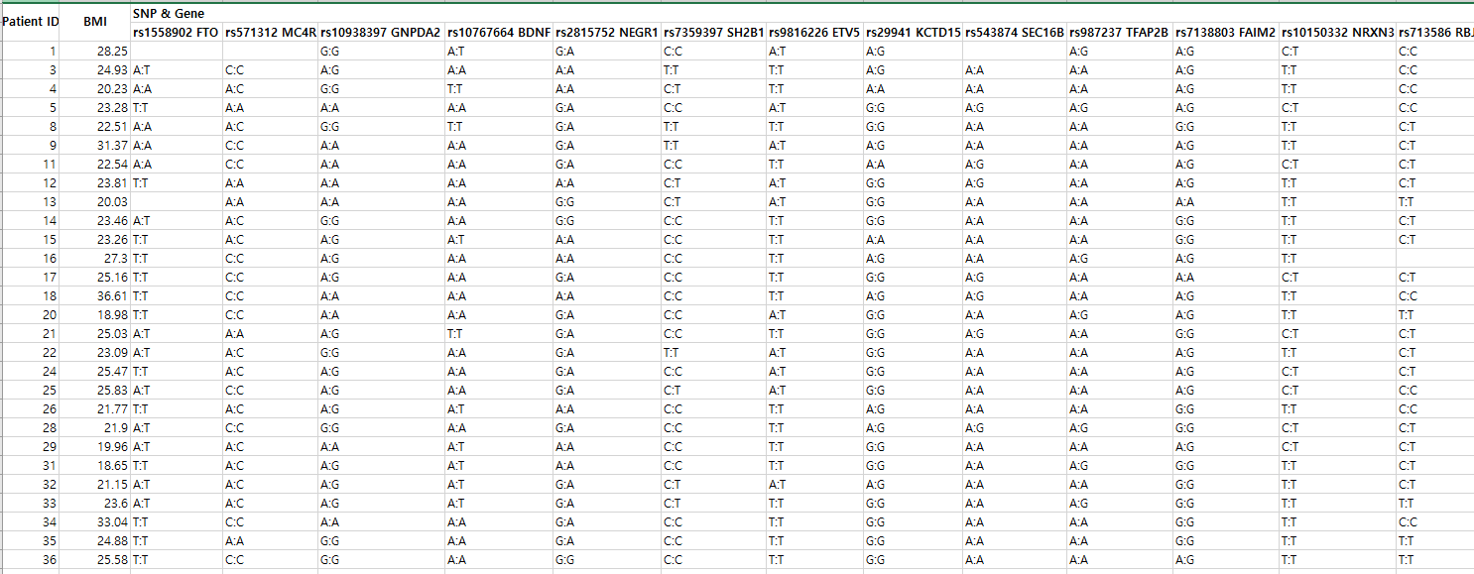
진행현황(3) : obesity-related clinical info + SNP info dataset
지난 줄거리
Start point: ToppGene
Joseph et al., Plos One, 2018

Slide 12
selection of obes. Related SNP (1)
지난 줄거리
Obesity-related SNP information
- SNP1: 0,1,2 / SNP2: 0,1,2 / …
- Polygenic risk score
* How to read BMI and genotype data from excel file

Slide 13
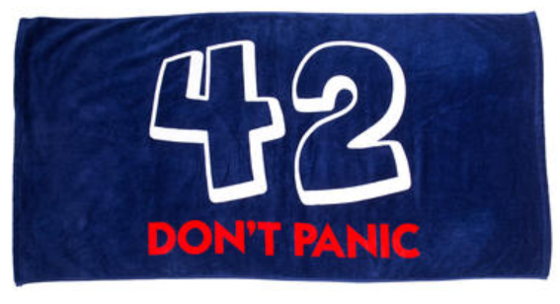
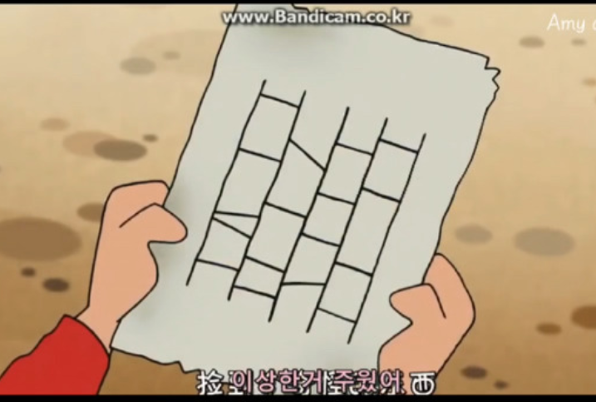

Slide 14
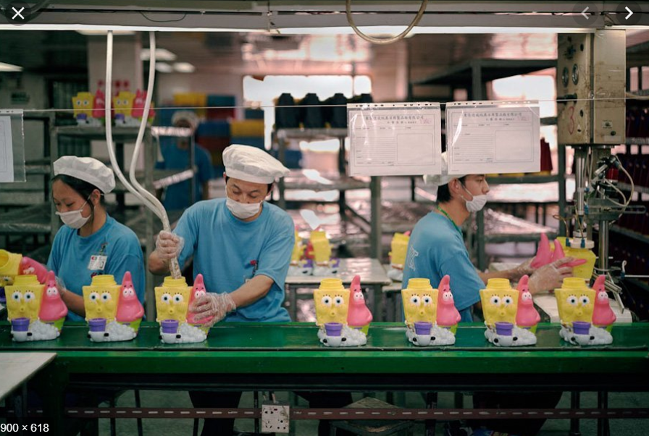

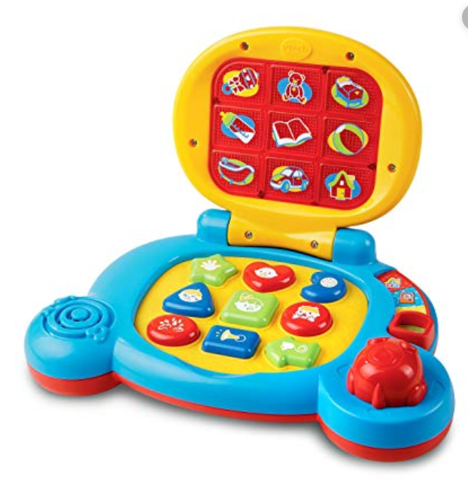
Toy program…
VS.

Slide 15

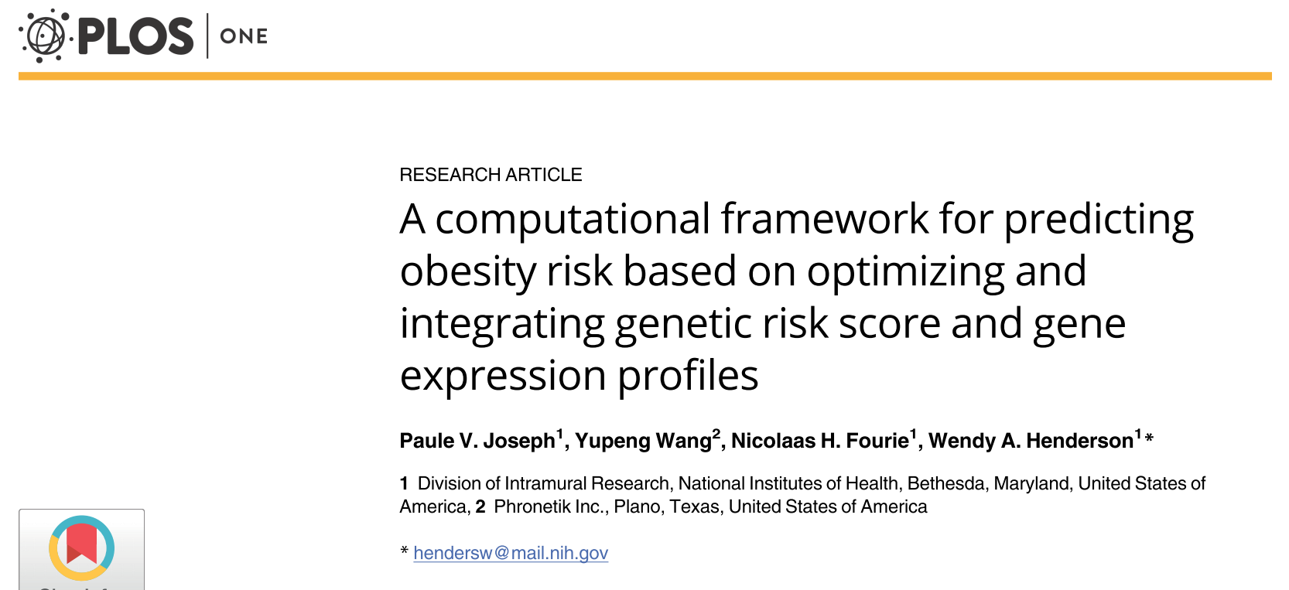

Slide 16
Materials and methods (I)
Design and setting (January 2009 to December 2015)
DNA extraction and genotyping OpenArray
RNA isolation, amplification
Microarray data processing and annotation
Correction for multiple testing
Additional quality control procedure

Slide 17
Materials and methods (II)
Computing the genetic risk score
Feature selection algorithm for SNP data
Feature selection algorithm for microarray data
Predictive modeling
Notes:
Criteria
INCLUSION CRITERIA:
To be included, patients must meet all of the following:
Have a history of abdominal pain for greater than 6 months
Males ages 13-45 years old or females ages 13-45 years old who have had their menses for at least 2 years
Provide written informed consent, prior to entering the study or undergoing any study procedures
EXCLUSION CRITERIA:
Patients with any of the following will be excluded:
Have a history of an organic GI disease (e.g., inflammatory bowel disease, celiac disease, biliary disorders, bowel resection) cardiac, pulmonary, neurologic, renal, endocrine, or gynecological pathology
Are currently taking medications for GI symptoms daily such as 5-HT3 antagonists/5-HT4 agonists, prokinetic drugs, laxatives (but not fiber supplements), anti-diarrheals or antispasmodics
Are currently taking other medications daily that would alter serotonin (e.g., serotonin specific reuptake inhibitors [SSRI]), catecholamines (e.g., tricycle antidepressants but not inhaled beta-agonist for mild-moderate asthma), cortisol (excluding inhaled corticosteroids)
Work during the late evening and night (as cortisol levels may be altered)
Severe co-morbid pain or psychiatric conditions (e.g., fibromyalgia, bipolar or psychotic disorder)
Take greater than 300 mg of caffeine containing beverages or food (e.g. chocolate) in the afternoon-evening or greater than 2 servings of alcohol containing beverages everyday (decaffeinated coffee is acceptable)
Are unable to give informed consent
Are unable to physically use the touch screen for the purpose of the study
Are visually impaired or currently institutionalized
Females who are pregnant or lactating
NINR employees, subordinates/relatives/ or co-workers
Any NIH employee who is a subordinate/relative/or co-worker of a study investigator

Slide 18
Computing the genetic risk score
For each sample, a genetic risk score was computed.
If the genotype of an SNP was homozygous for the "affect allele," a value of 2 was assigned for that SNP.
If the genotype was heterozygous for the "affect allele/other allele," a value of 1 was assigned.
If the genotype was homozygous for the "other allele," a value of 0 was assigned.
The genetic risk score was the summation of the values of included SNPs divided by the number of included SNPs.

Slide 19

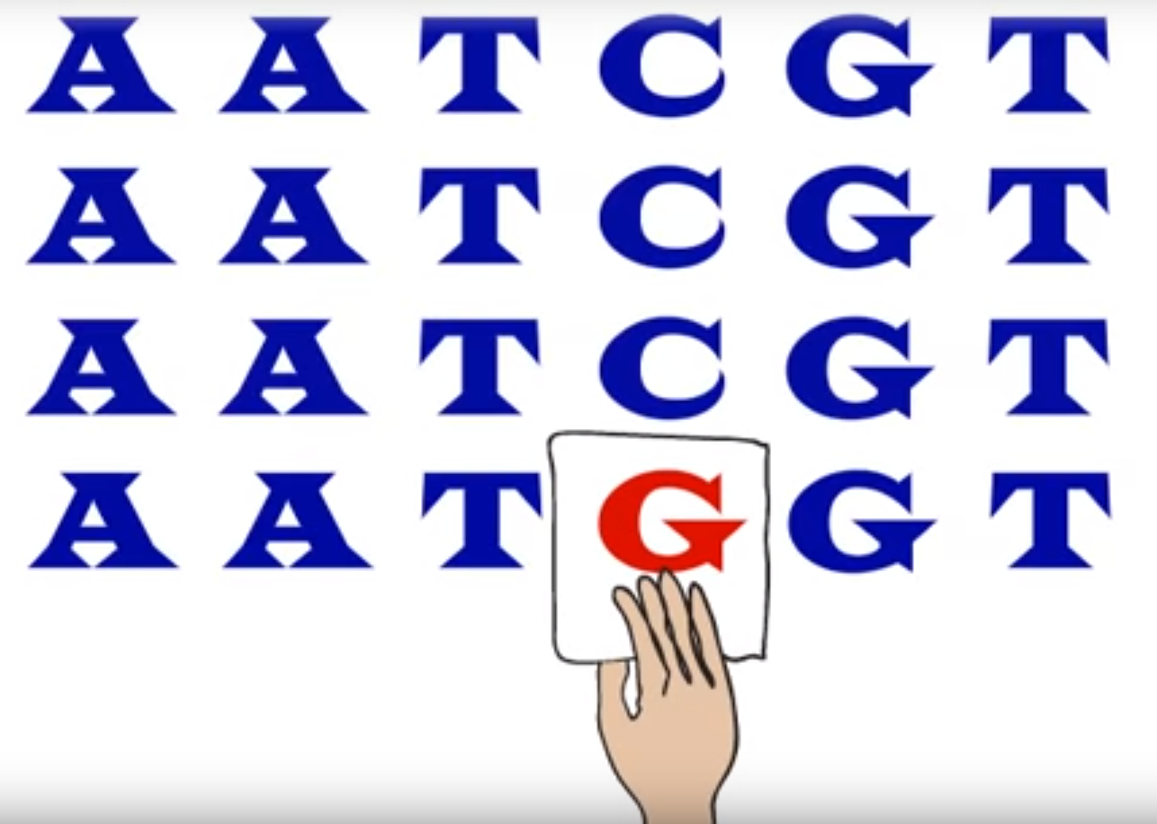
single nucleotide polymorphism (SNP)
단일염기 다형성 (SNP) DNA 염기서열에서 하나의 염기서열 차이를 보이는 유전적 변화 또는 변이 중 인구집단에서 1% 이 상의 빈도로 발생하는 것을 지칭함

Slide 20
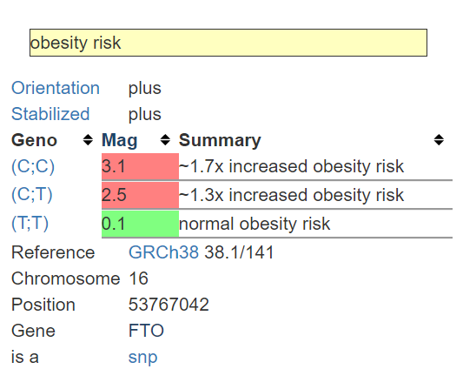
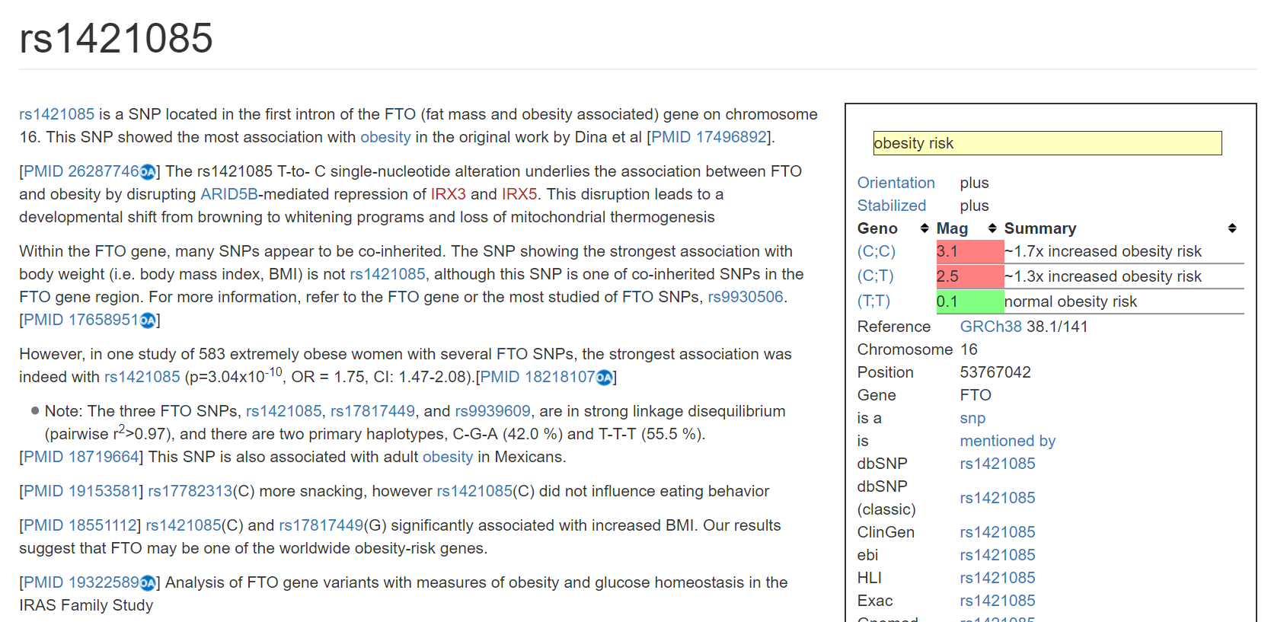

Slide 21
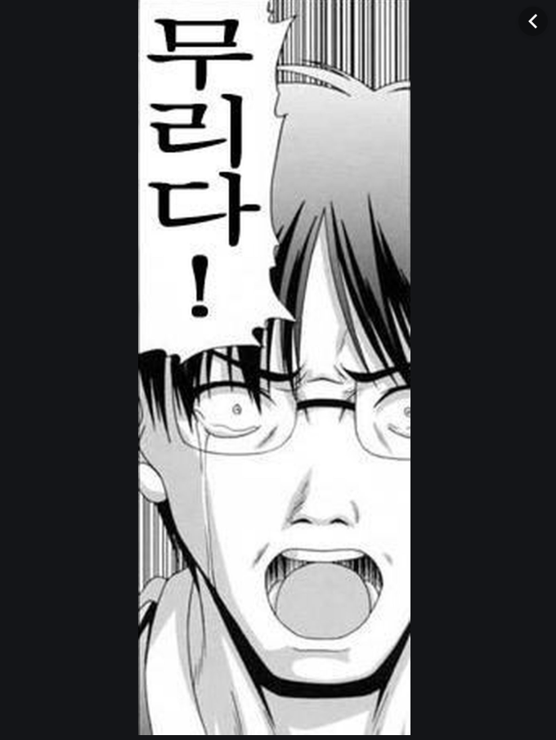
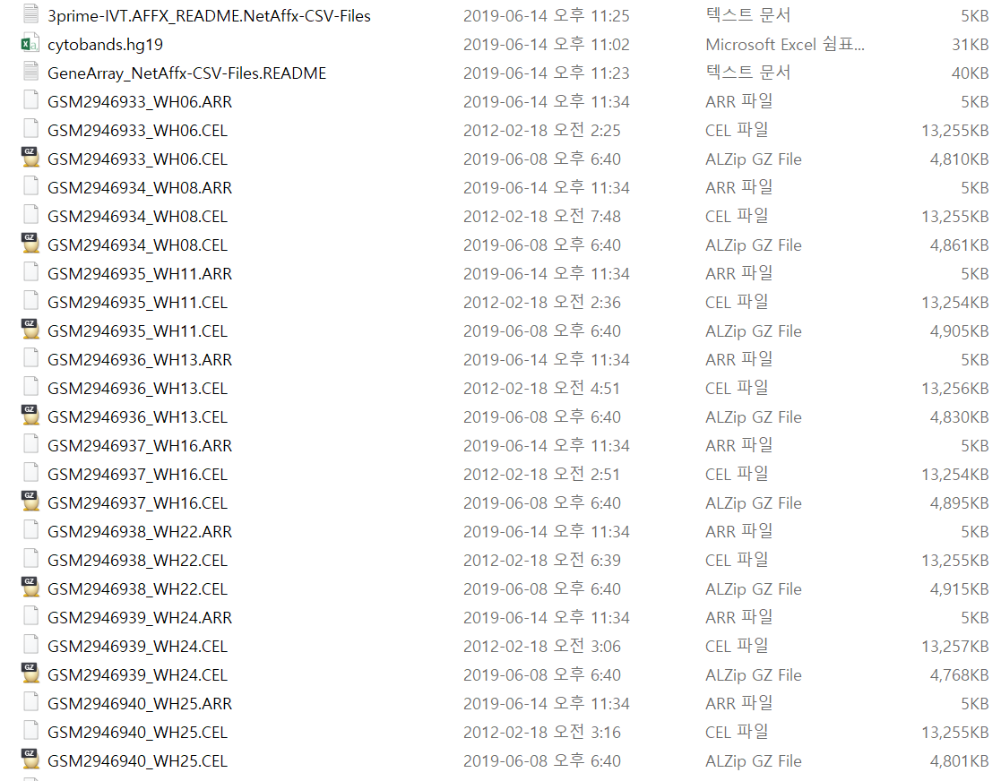
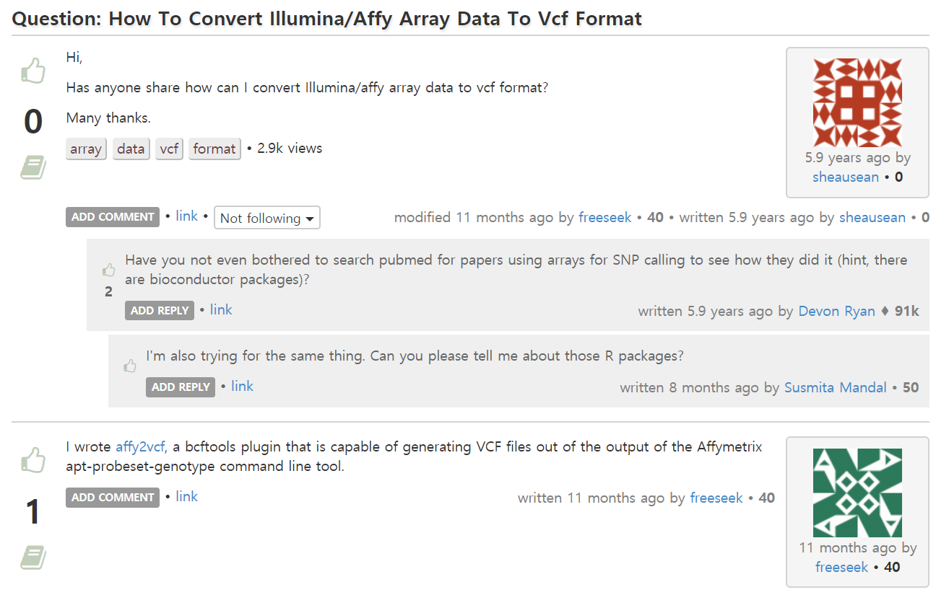
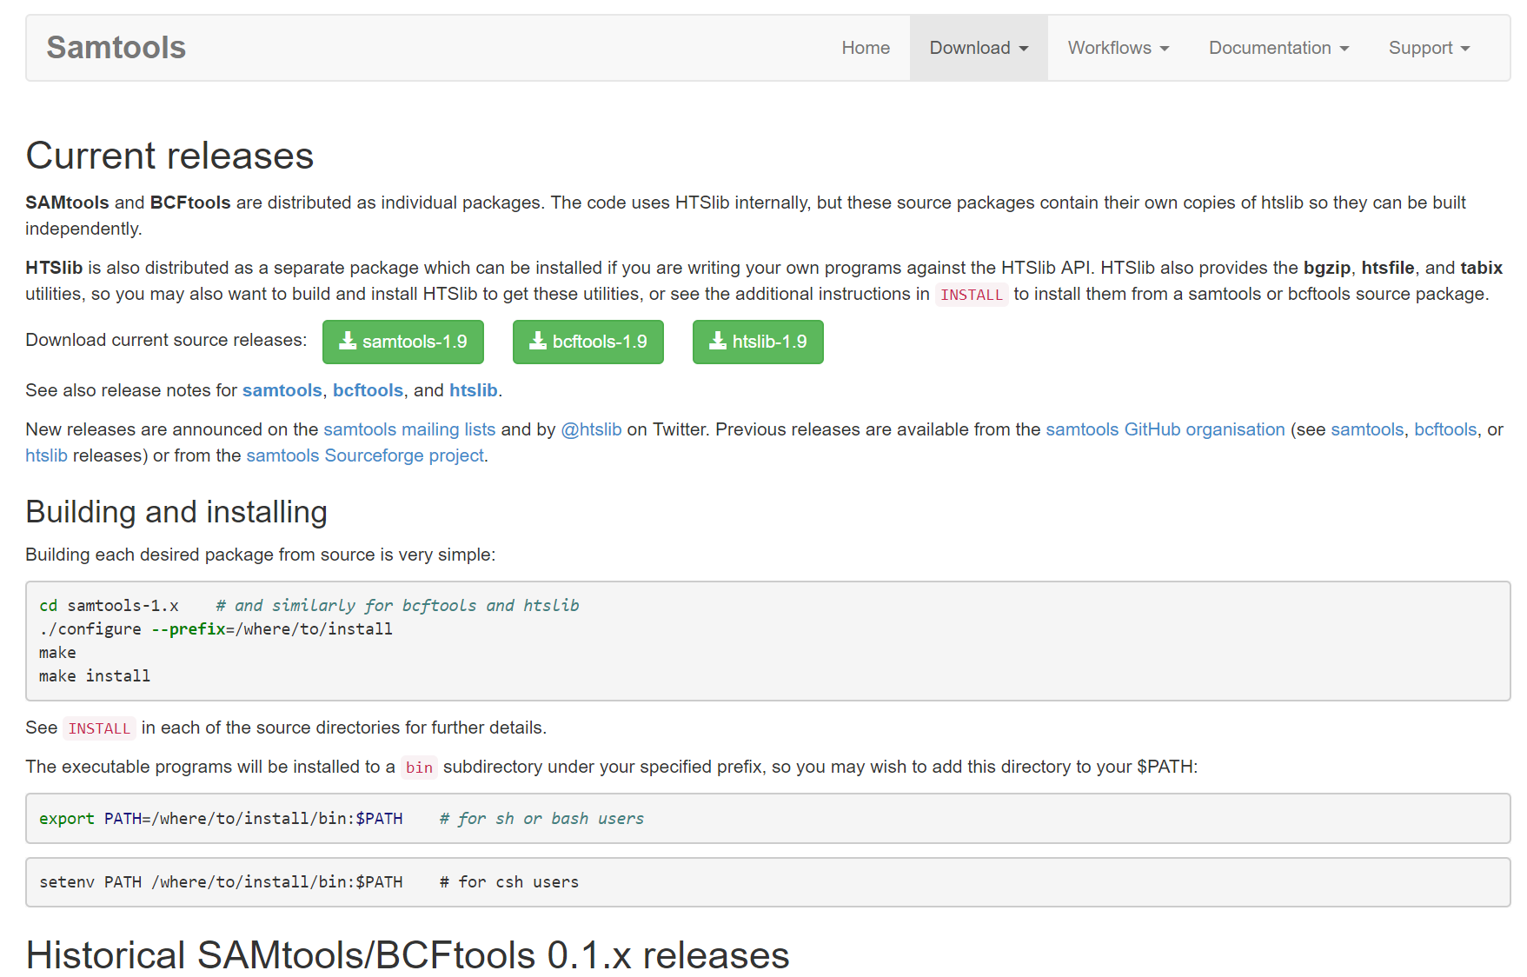

Slide 22
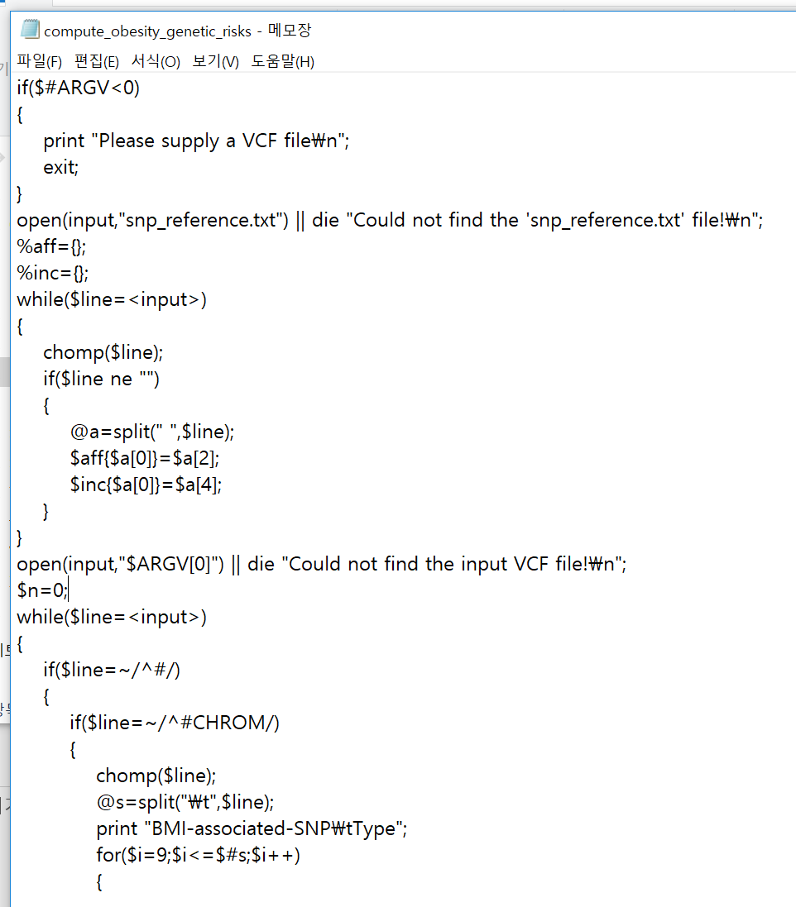
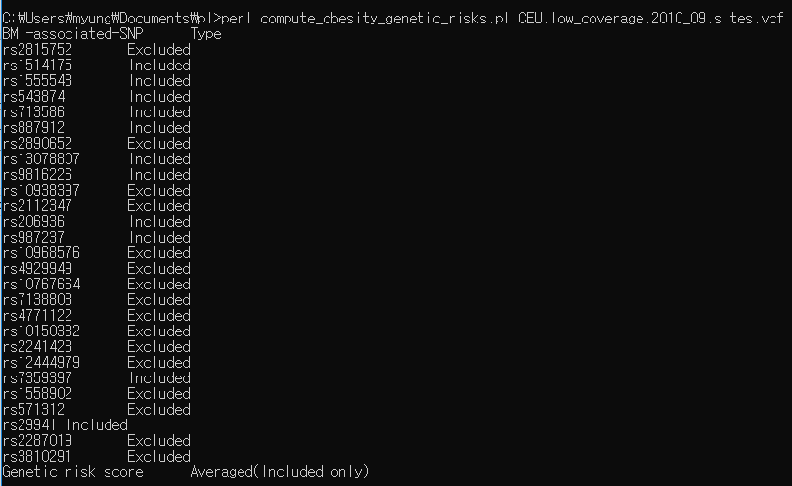
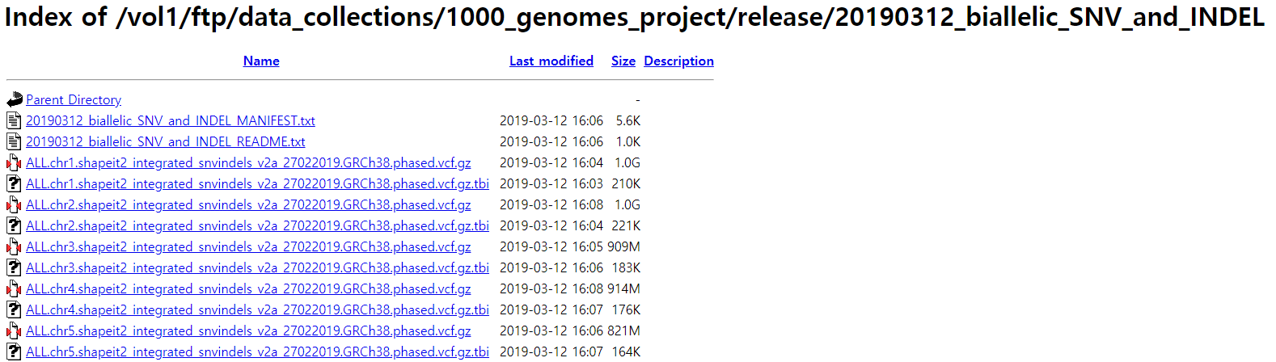
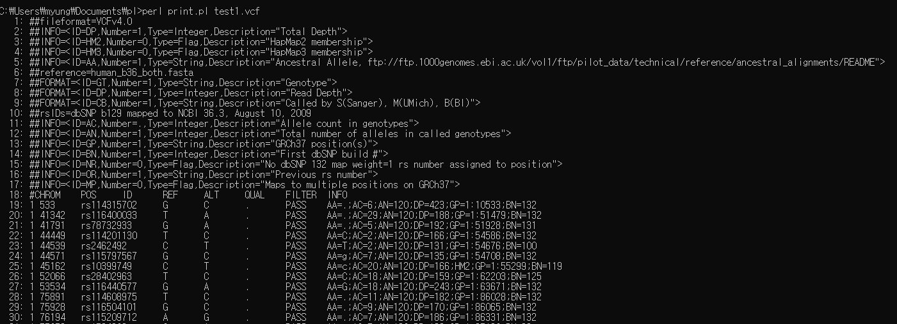

Slide 23
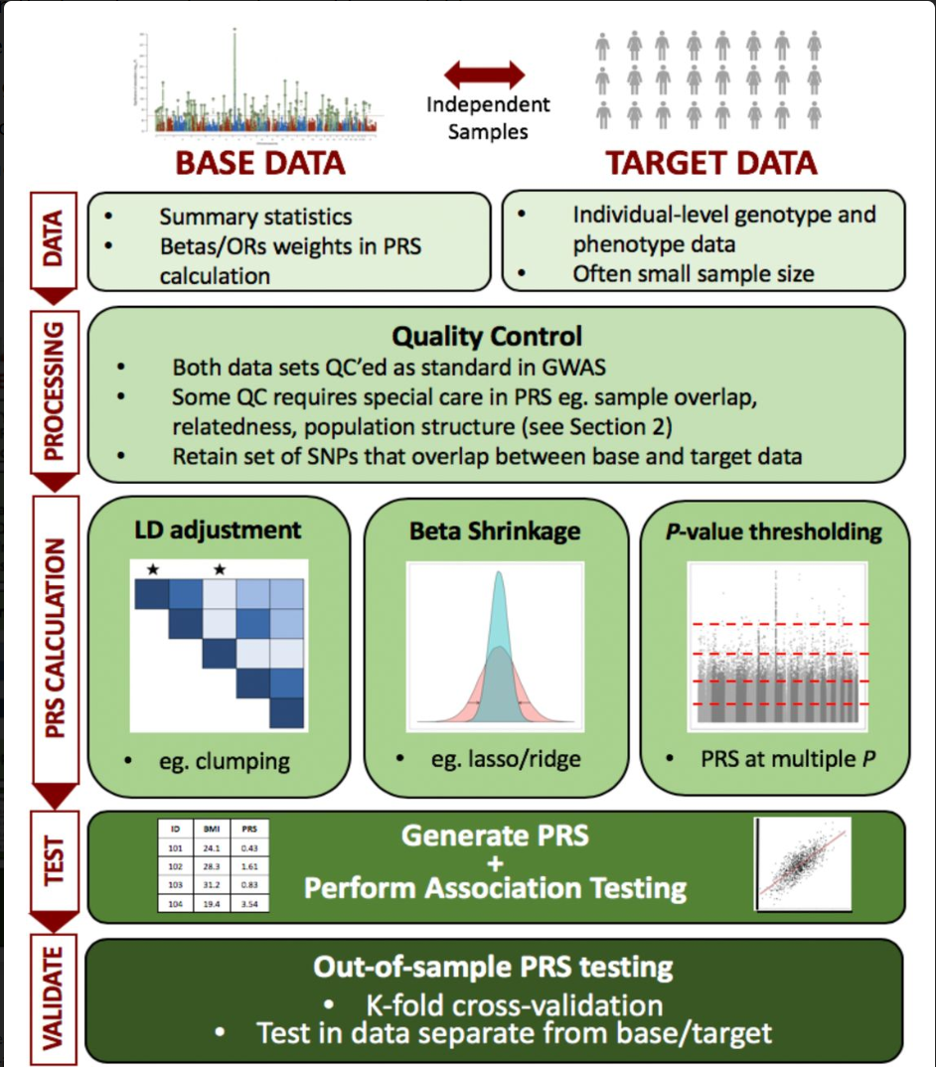
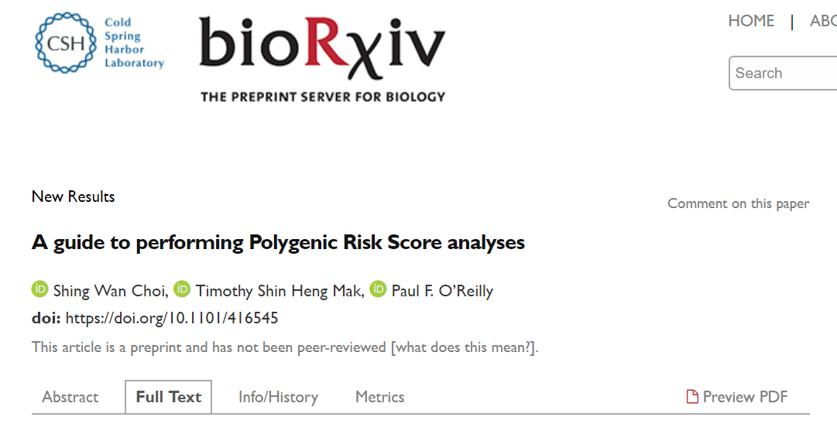

Slide 24
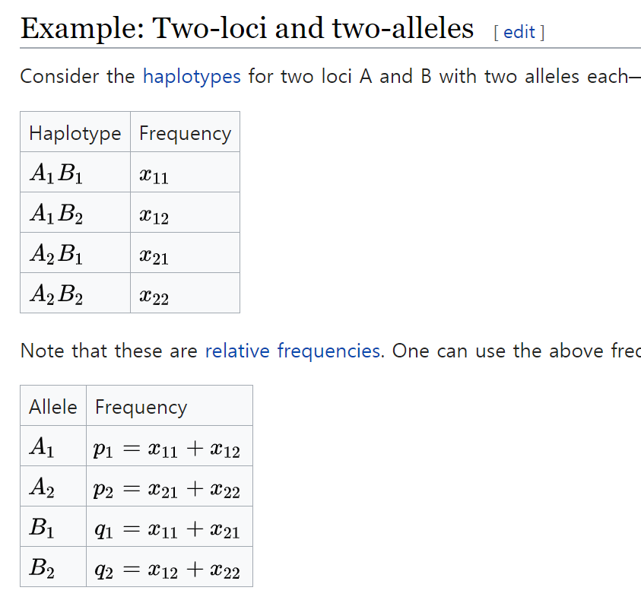
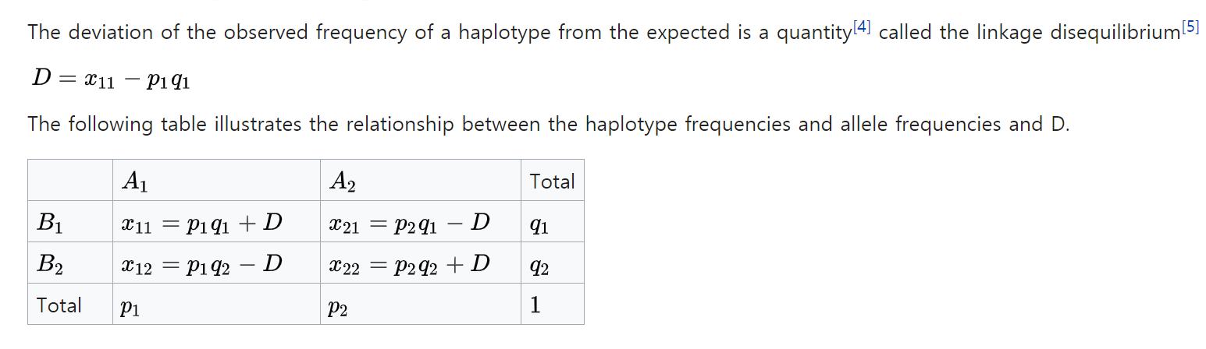
linkage disequilibrium(LD)
연관불평형 (linkage disequilibrium) 염색체의 서로 다른 두 유전자좌 (locus)에서 관측되는 대립유전자 (allele) 들간에 존재하는 무작위적이지 않은 연관관계를 의미함.
두 유전자좌 에서 관측된 대립유전자들로 이루어진 서로 다른 하플로타입(haplotype) 빈도가 무작위로 나타나지 않고 서로 다르게 나타날 경우 두 유전자좌는 연관불평형 관계에 있을 가능성이 있다.

Slide 25
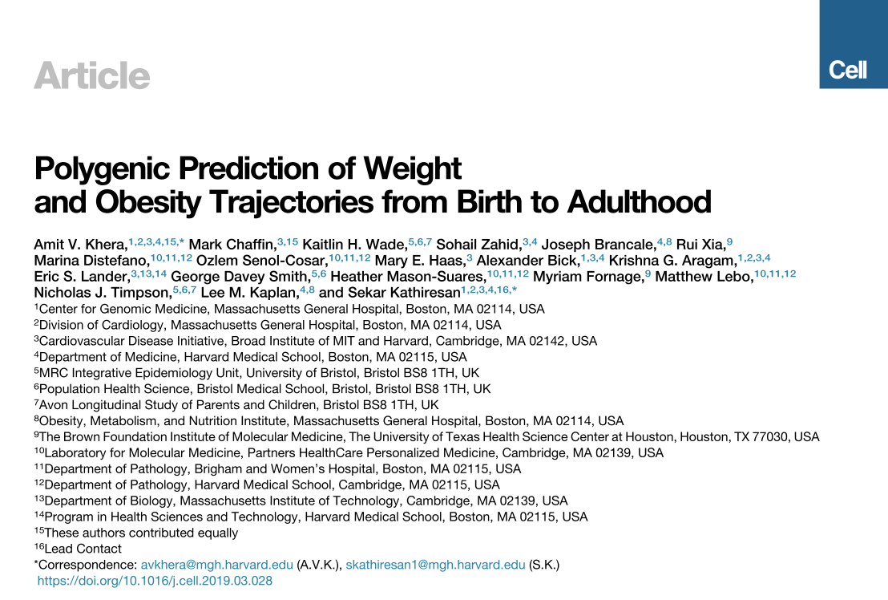
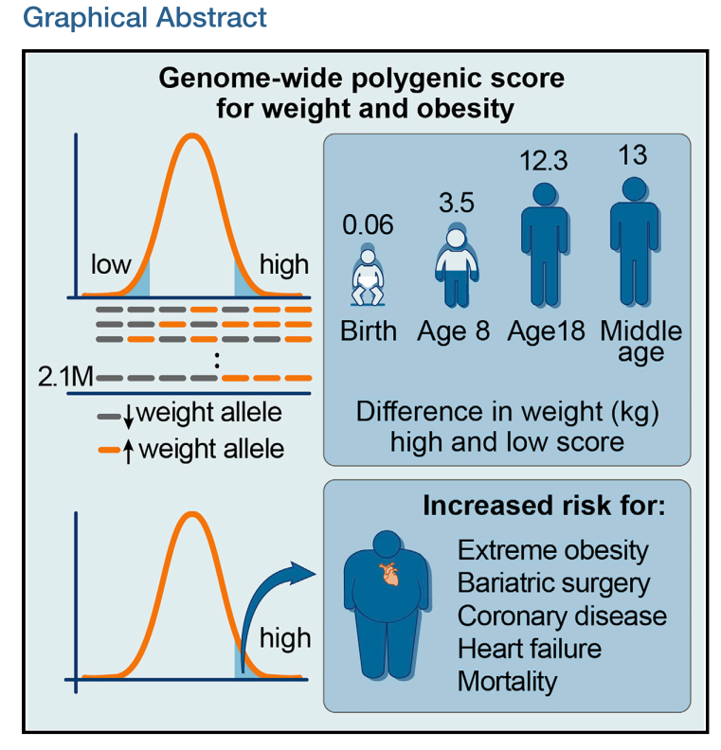
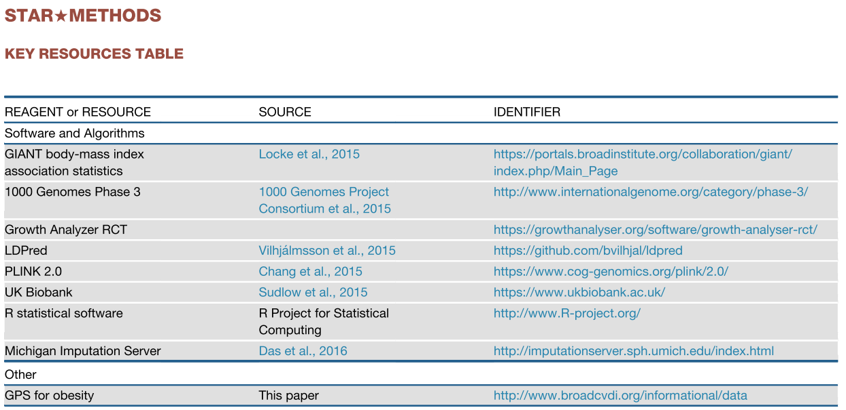

Slide 26
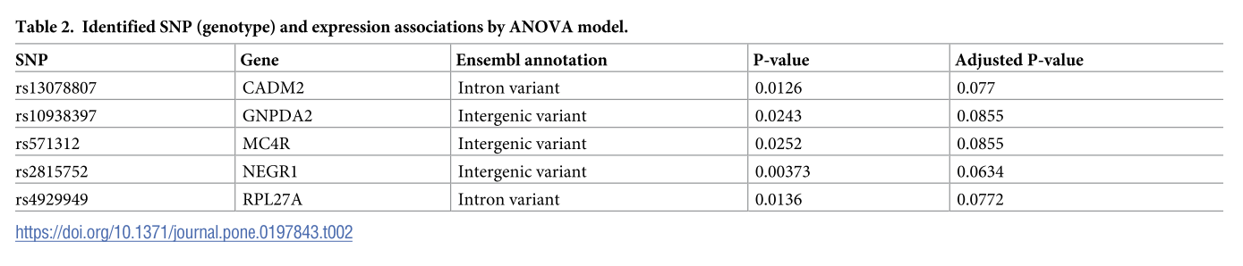
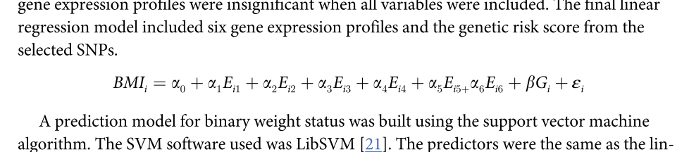
Materials and methods (II)
Computing the genetic risk score
Feature selection algorithm for SNP data
Feature selection algorithm for microarray data
Predictive modeling
Notes:
Criteria
INCLUSION CRITERIA:
To be included, patients must meet all of the following:
Have a history of abdominal pain for greater than 6 months
Males ages 13-45 years old or females ages 13-45 years old who have had their menses for at least 2 years
Provide written informed consent, prior to entering the study or undergoing any study procedures
EXCLUSION CRITERIA:
Patients with any of the following will be excluded:
Have a history of an organic GI disease (e.g., inflammatory bowel disease, celiac disease, biliary disorders, bowel resection) cardiac, pulmonary, neurologic, renal, endocrine, or gynecological pathology
Are currently taking medications for GI symptoms daily such as 5-HT3 antagonists/5-HT4 agonists, prokinetic drugs, laxatives (but not fiber supplements), anti-diarrheals or antispasmodics
Are currently taking other medications daily that would alter serotonin (e.g., serotonin specific reuptake inhibitors [SSRI]), catecholamines (e.g., tricycle antidepressants but not inhaled beta-agonist for mild-moderate asthma), cortisol (excluding inhaled corticosteroids)
Work during the late evening and night (as cortisol levels may be altered)
Severe co-morbid pain or psychiatric conditions (e.g., fibromyalgia, bipolar or psychotic disorder)
Take greater than 300 mg of caffeine containing beverages or food (e.g. chocolate) in the afternoon-evening or greater than 2 servings of alcohol containing beverages everyday (decaffeinated coffee is acceptable)
Are unable to give informed consent
Are unable to physically use the touch screen for the purpose of the study
Are visually impaired or currently institutionalized
Females who are pregnant or lactating
NINR employees, subordinates/relatives/ or co-workers
Any NIH employee who is a subordinate/relative/or co-worker of a study investigator

Slide 27
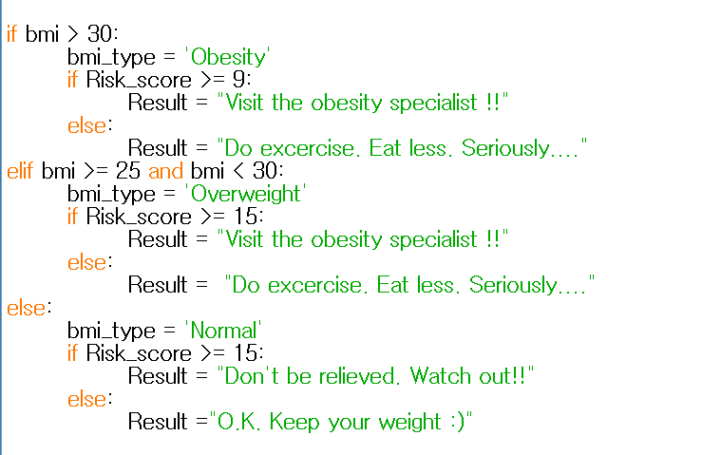
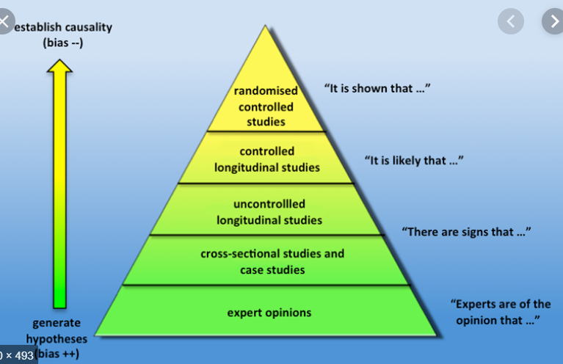

Slide 28
결과 시연

Slide 29
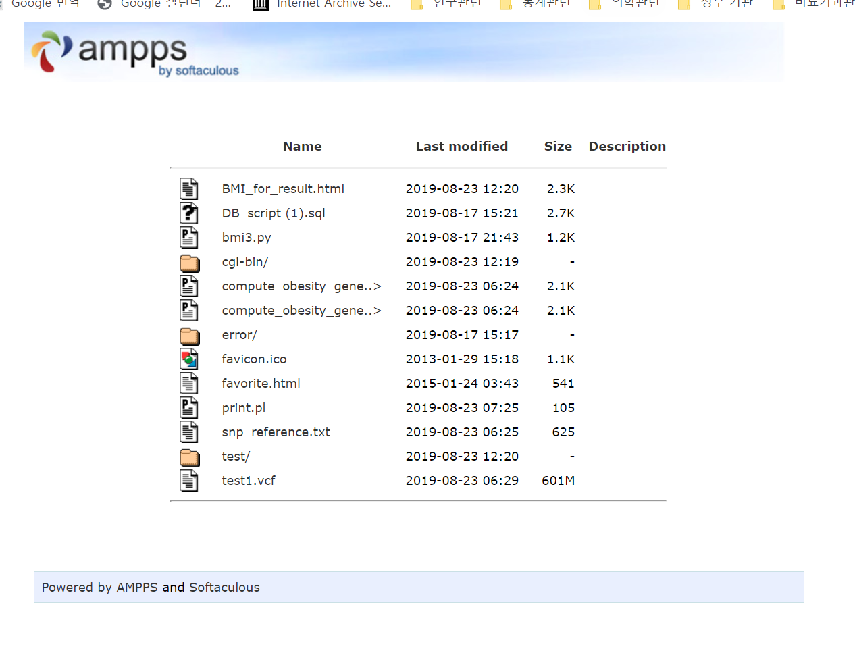

Slide 30
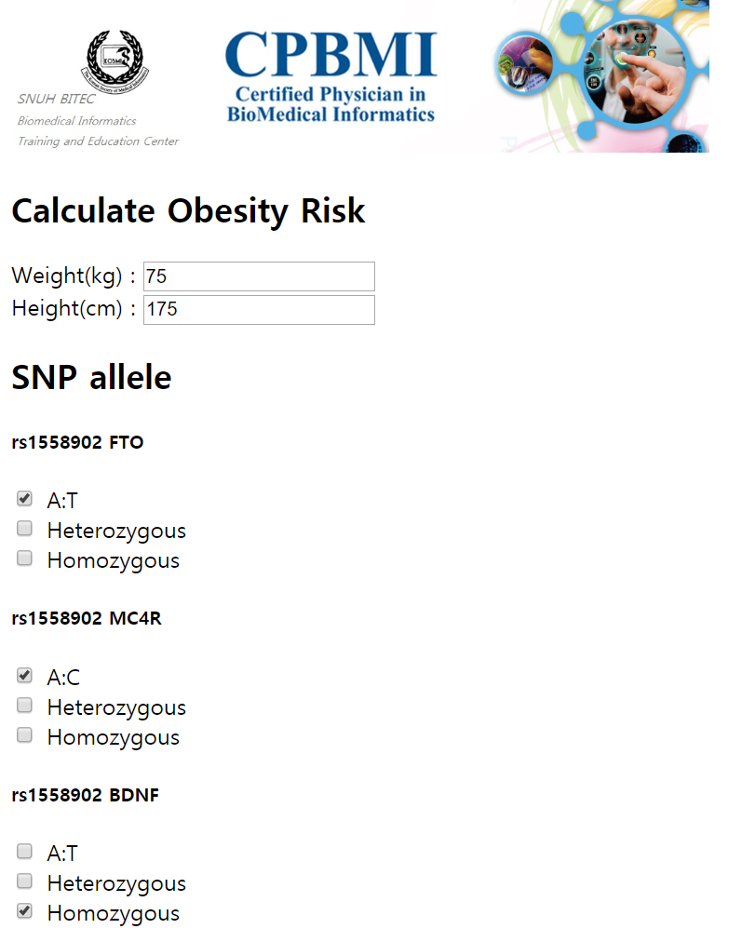
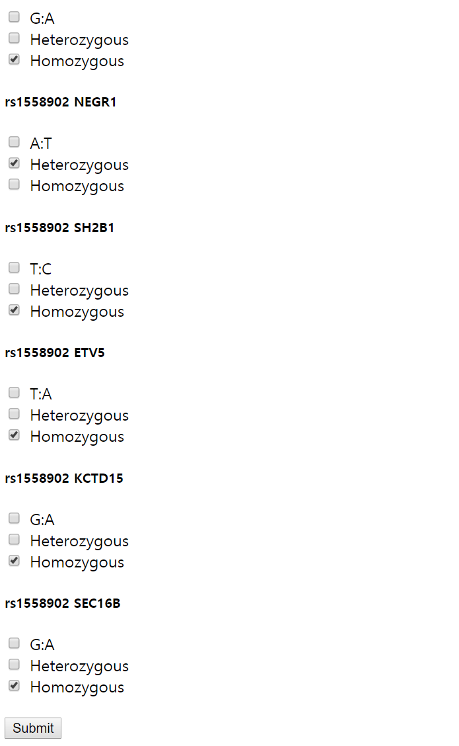

Slide 31
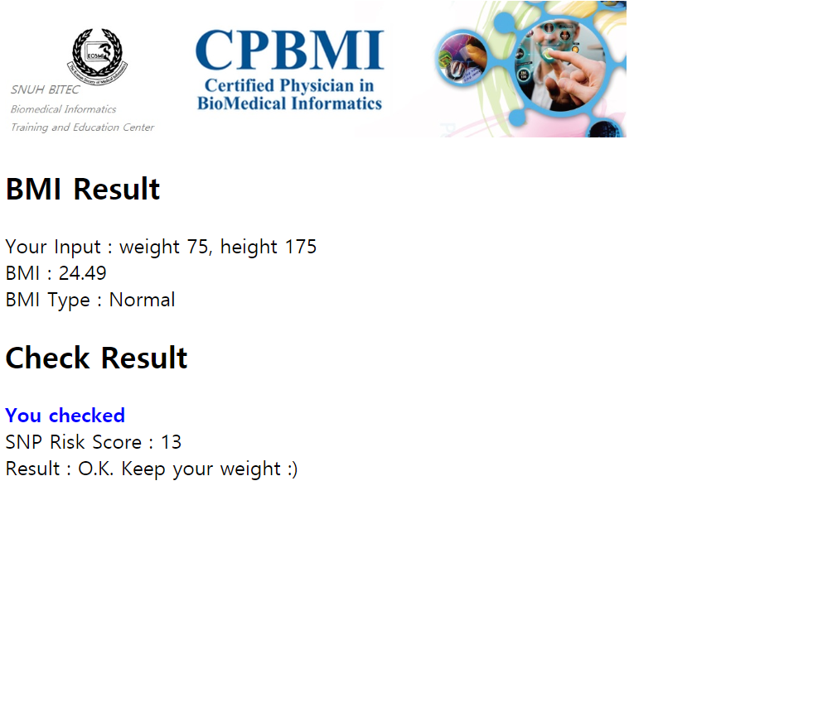

Slide 32
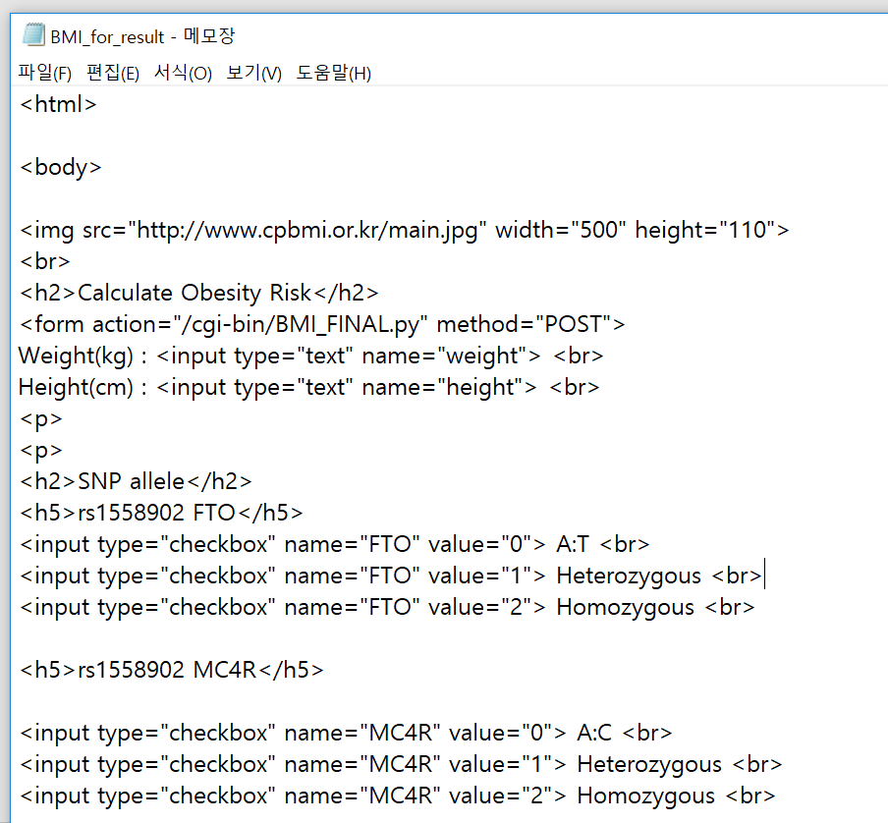

Slide 34
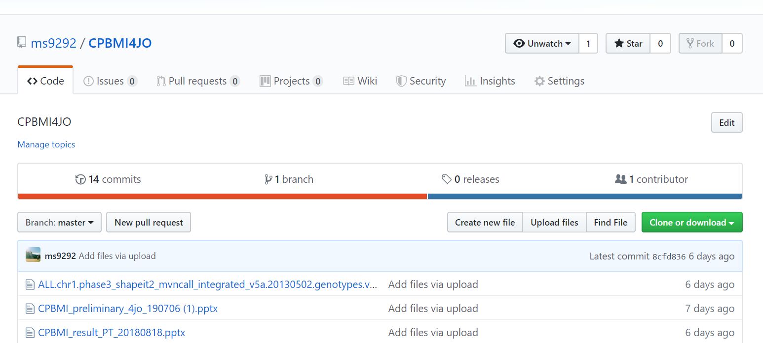
Genome polygenic scores are made freely available to the academic community for research use. Parties interested in using the scores for commercial purposes should contact the CPBMI office.

Slide 35
Toy program
Obesity risk calculator
Ver 0.3 20190817
Prototype
Only 3 SNPs available
Ver 0.2 20190818
Extended to 9 SNPs
Open Web service
Open Github for collaboration

Slide 36
Toy program
Obesity risk calculator
Ver 0.3 20190819
Sample VCF file acquired
Risk calculation from VCF file with reference SNPs
Ver 0.5 20190823
Interface upgrade (add image shot…)
test 2nd VCF file

Slide 37
대단히 감사합니다!

